Slide 1
St. Louis Central Corridor West Building Permits
Monthly Report: December 2021

Slide 2
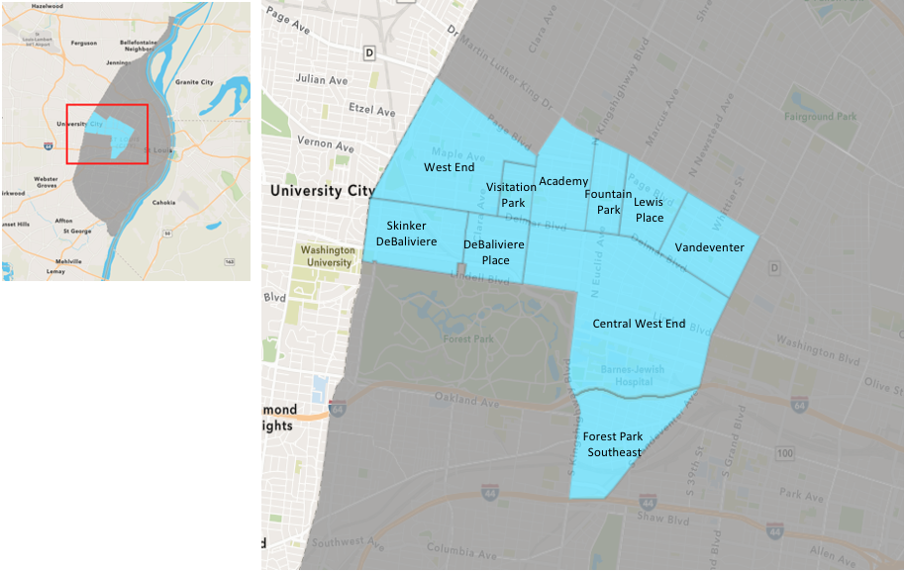
St. Louis Neighborhood Spatial Reference

Slide 3
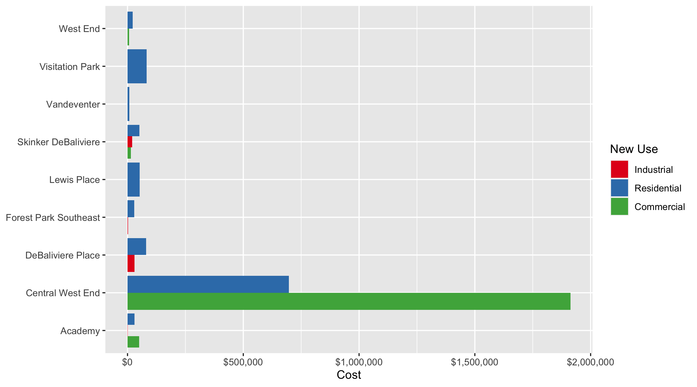
Neighborhood Summary: Average Building Permit Cost

Slide 4
Neighborhood Summary
December 2021 | December 2021 | December 2021 | December 2021
Neighborhood | Average Cost | # of Permits | Total Value of Permits
Academy | $27,984.00 | 4 | $111,936
Central West End | $1,351,763.08 | 26 | $35,145,840
DeBaliviere Place | $55,000.00 | 2 | $110,000
Forest Park Southeast | $26,616.67 | 12 | $319,400
Fountain Park | $0.00 | 0 | $0
Lewis Place | $52,950.00 | 2 | $105,900
Skinker DeBaliviere | $44,168.50 | 10 | $441,685
Vandeventer | $7,622.00 | 1 | $7,622
Visitation Park | $82,500.00 | 2 | $165,000
West End | $16,719.64 | 11 | $183,916
Last 6 Months | Last 6 Months | Last 6 Months | Last 6 Months
Neighborhood | Average Cost | # of Permits | Total Value of Permits
Academy | $29,818.79 | 28 | $834,926
Central West End | $583,485.06 | 231 | $134,785,049
DeBaliviere Place | $93,139.54 | 26 | $2,421,628
Forest Park Southeast | $56,203.99 | 107 | $6,013,827
Fountain Park | $381,943.70 | 10 | $3,819,437
Lewis Place | $101,874.00 | 14 | $1,426,236
Skinker DeBaliviere | $137,591.00 | 49 | $6,741,959
Vandeventer | $85,859.25 | 16 | $1,373,748
Visitation Park | $42,475.00 | 4 | $169,900
West End | $37,550.45 | 99 | $3,717,495

Slide 5
Core Neighborhoods

Slide 6
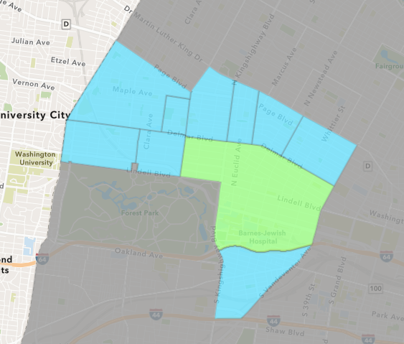
Central West End
December 2021 Neighborhood Cost Breakdown
Mean: $1,351,763
Median: $18,150
Range: $100 - $25,000,000

Slide 7
Central West End: Summary Notes
26 building permits in December 2021
8.33% change compared to December 2020 (24 total building permits)
$1,351,763: Average building permit cost in December 2021
-10.26% change compared to December 2020 ($1,506,369)
419 total building permits in 2021
10.55% change YTD compared to this time in 2020 (379 total building permits)
$981,186: YTD average building permit cost in 2021
161.33% change YTD compared to this time in 2020 ($375,453)

Slide 8
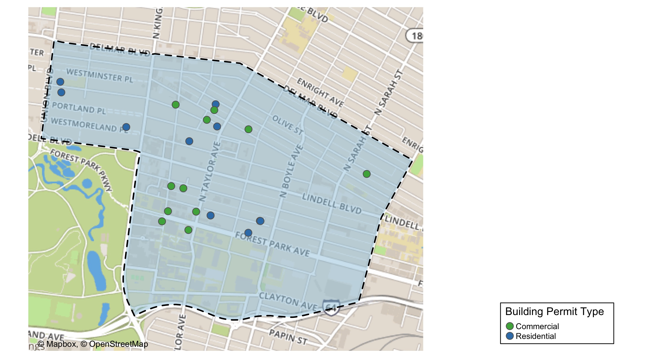
Central West End

Slide 9
Neighborhood Summary
December 2021 | December 2021 | December 2021 | December 2021
Permit Use | Average Cost | # of Permits | Total Value of Permits
Commercial | $1,912,740.4 | 14 | $26,778,365
Industrial | $0.0 | 0 | $0
Residential | $697,289.6 | 12 | $8,367,475
Last 6 Months | Last 6 Months | Last 6 Months | Last 6 Months
Permit Use | Average Cost | # of Permits | Total Value of Permits
Commercial | $1,501,255.19 | 79 | $118,599,160
Industrial | $52,085.71 | 14 | $729,200
Residential | $112,004.99 | 138 | $15,456,689

Slide 10
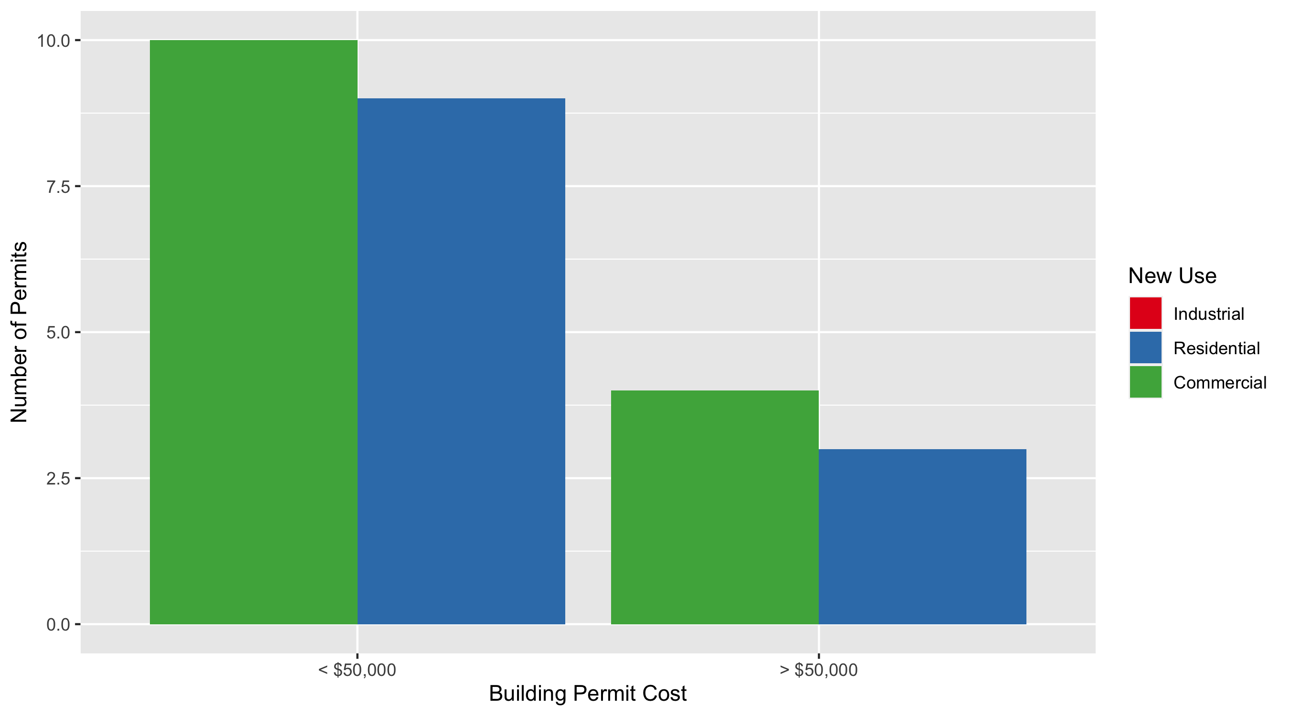
Central West End Permit Cost Breakdown

Slide 11
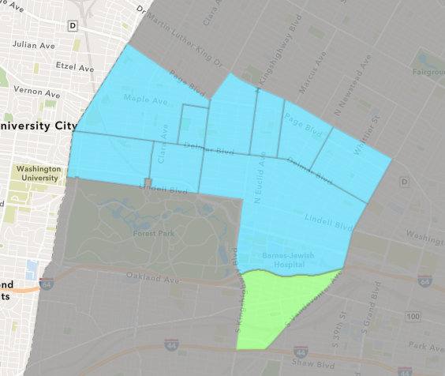
Forest Park Southeast
December 2021 Neighborhood Cost Breakdown
Mean: $26,617
Median: $4,500
Range: $500 - $250,000

Slide 12
Forest Park Southeast: Summary Notes
12 building permits in December 2021
50.00% change compared to December 2020 (8 total building permits)
$26,617: Average building permit cost in December 2021
-97.51% change compared to December 2020 ($1,066,938)
175 total building permits in 2021
47.06% change YTD compared to this time in 2020 (119 total building permits)
$361,387: YTD average building permit cost in 2021
59.06% change YTD compared to this time in 2020 ($227,198)

Slide 13
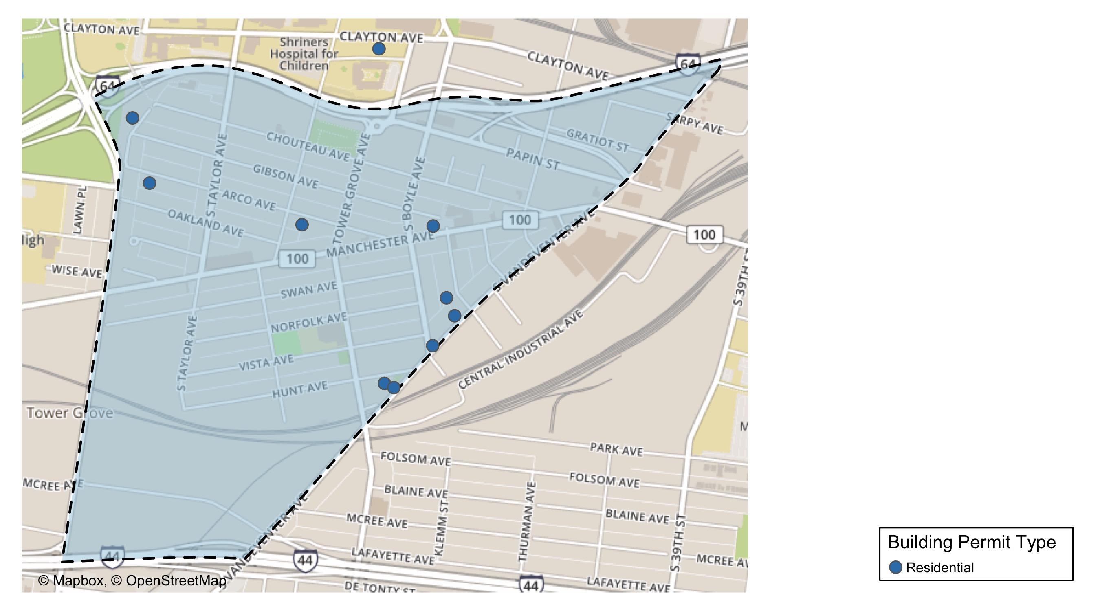
Forest Park Southeast

Slide 14
Neighborhood Summary
December 2021 | December 2021 | December 2021 | December 2021
Permit Use | Average Cost | # of Permits | Total Value of Permits
Commercial | $0.00 | 0 | $0
Industrial | $2,500.00 | 1 | $2,500
Residential | $28,809.09 | 11 | $316,900
Last 6 Months | Last 6 Months | Last 6 Months | Last 6 Months
Permit Use | Average Cost | # of Permits | Total Value of Permits
Commercial | $118,123.955 | 22 | $2,598,727
Industrial | $9,027.143 | 7 | $63,190
Residential | $42,973.205 | 78 | $3,351,910

Slide 15
Forest Park Southeast Individual Permit Breakdown
nbhd_name | Owner | New Use | Cost | address
Forest Park Southeast | CLEVELAND, IVY N | Residential | $250,000 | 4247 CHOUTEAU AV
Forest Park Southeast | BRIDGETT, RAYMOND EUGENE & | Residential | $900 | 1308 S BOYLE AV
Forest Park Southeast | JEMZ INVESTMENTS & PROPERTIES LLC | Residential | $10,000 | 4319 HUNT AV
Forest Park Southeast | GREEN ST 4565 MCREE INVESTORS LLC AT | Industrial | $2,500 | 4565 MCREE AV
Forest Park Southeast | ALTENHOFEN, MICHAEL & MARI E | Residential | $5,000 | 4463 GIBSON AV
Forest Park Southeast | HAGENE, ANDREW | Residential | $500 | 4560 CHOUTEAU AV
Forest Park Southeast | DAZ PROPERTIES | Residential | $4,000 | 4566 GIBSON AV
Forest Park Southeast | ANZAC DEVELOPMENTS | Residential | $20,000 | 4343 HUNT AV
Forest Park Southeast | PARK EAST II LP | Residential | $5,000 | 4436 CHOUTEAU AV
Forest Park Southeast | TOMASELLO, MICHAEL | Residential | $15,000 | 1216 S BOYLE AV
Forest Park Southeast | GOOD SAMARITAN SERVICE CENTER | Residential | $3,000 | 1300 S BOYLE AV
Forest Park Southeast | ASFAW, SELAMANWIT | Residential | $3,500 | 4559 CHOUTEAU AV

Slide 16
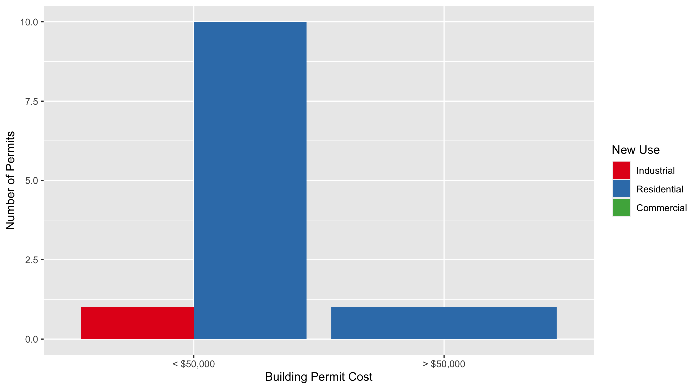
Forest Park Southeast Permit Cost Breakdown

Slide 17
Expanded Service Area

Slide 18
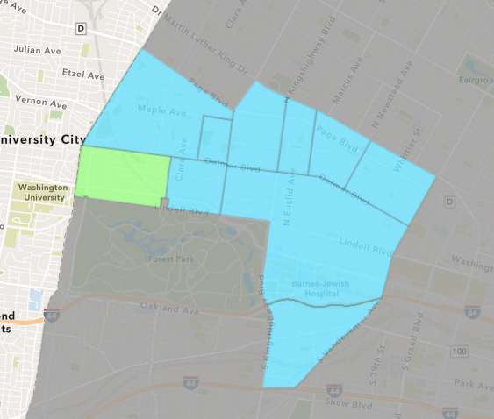
Skinker DeBaliviere
December 2021 Neighborhood Cost Breakdown
Mean: $44,168
Median: $29,888
Range: $5,455 - $110,000

Slide 19
Skinker DeBaliviere: Summary Notes
10 building permits in December 2021
25.00% change compared to December 2020 (8 total building permits)
$44,168: Average building permit cost in December 2021
-27.83% change compared to December 2020 ($61,200)
90 total building permits in 2021
-22.41% change YTD compared to this time in 2020 (116 total building permits)
$89,270: YTD average building permit cost in 2021
-84.45% change YTD compared to this time in 2020 ($574,155)

Slide 20
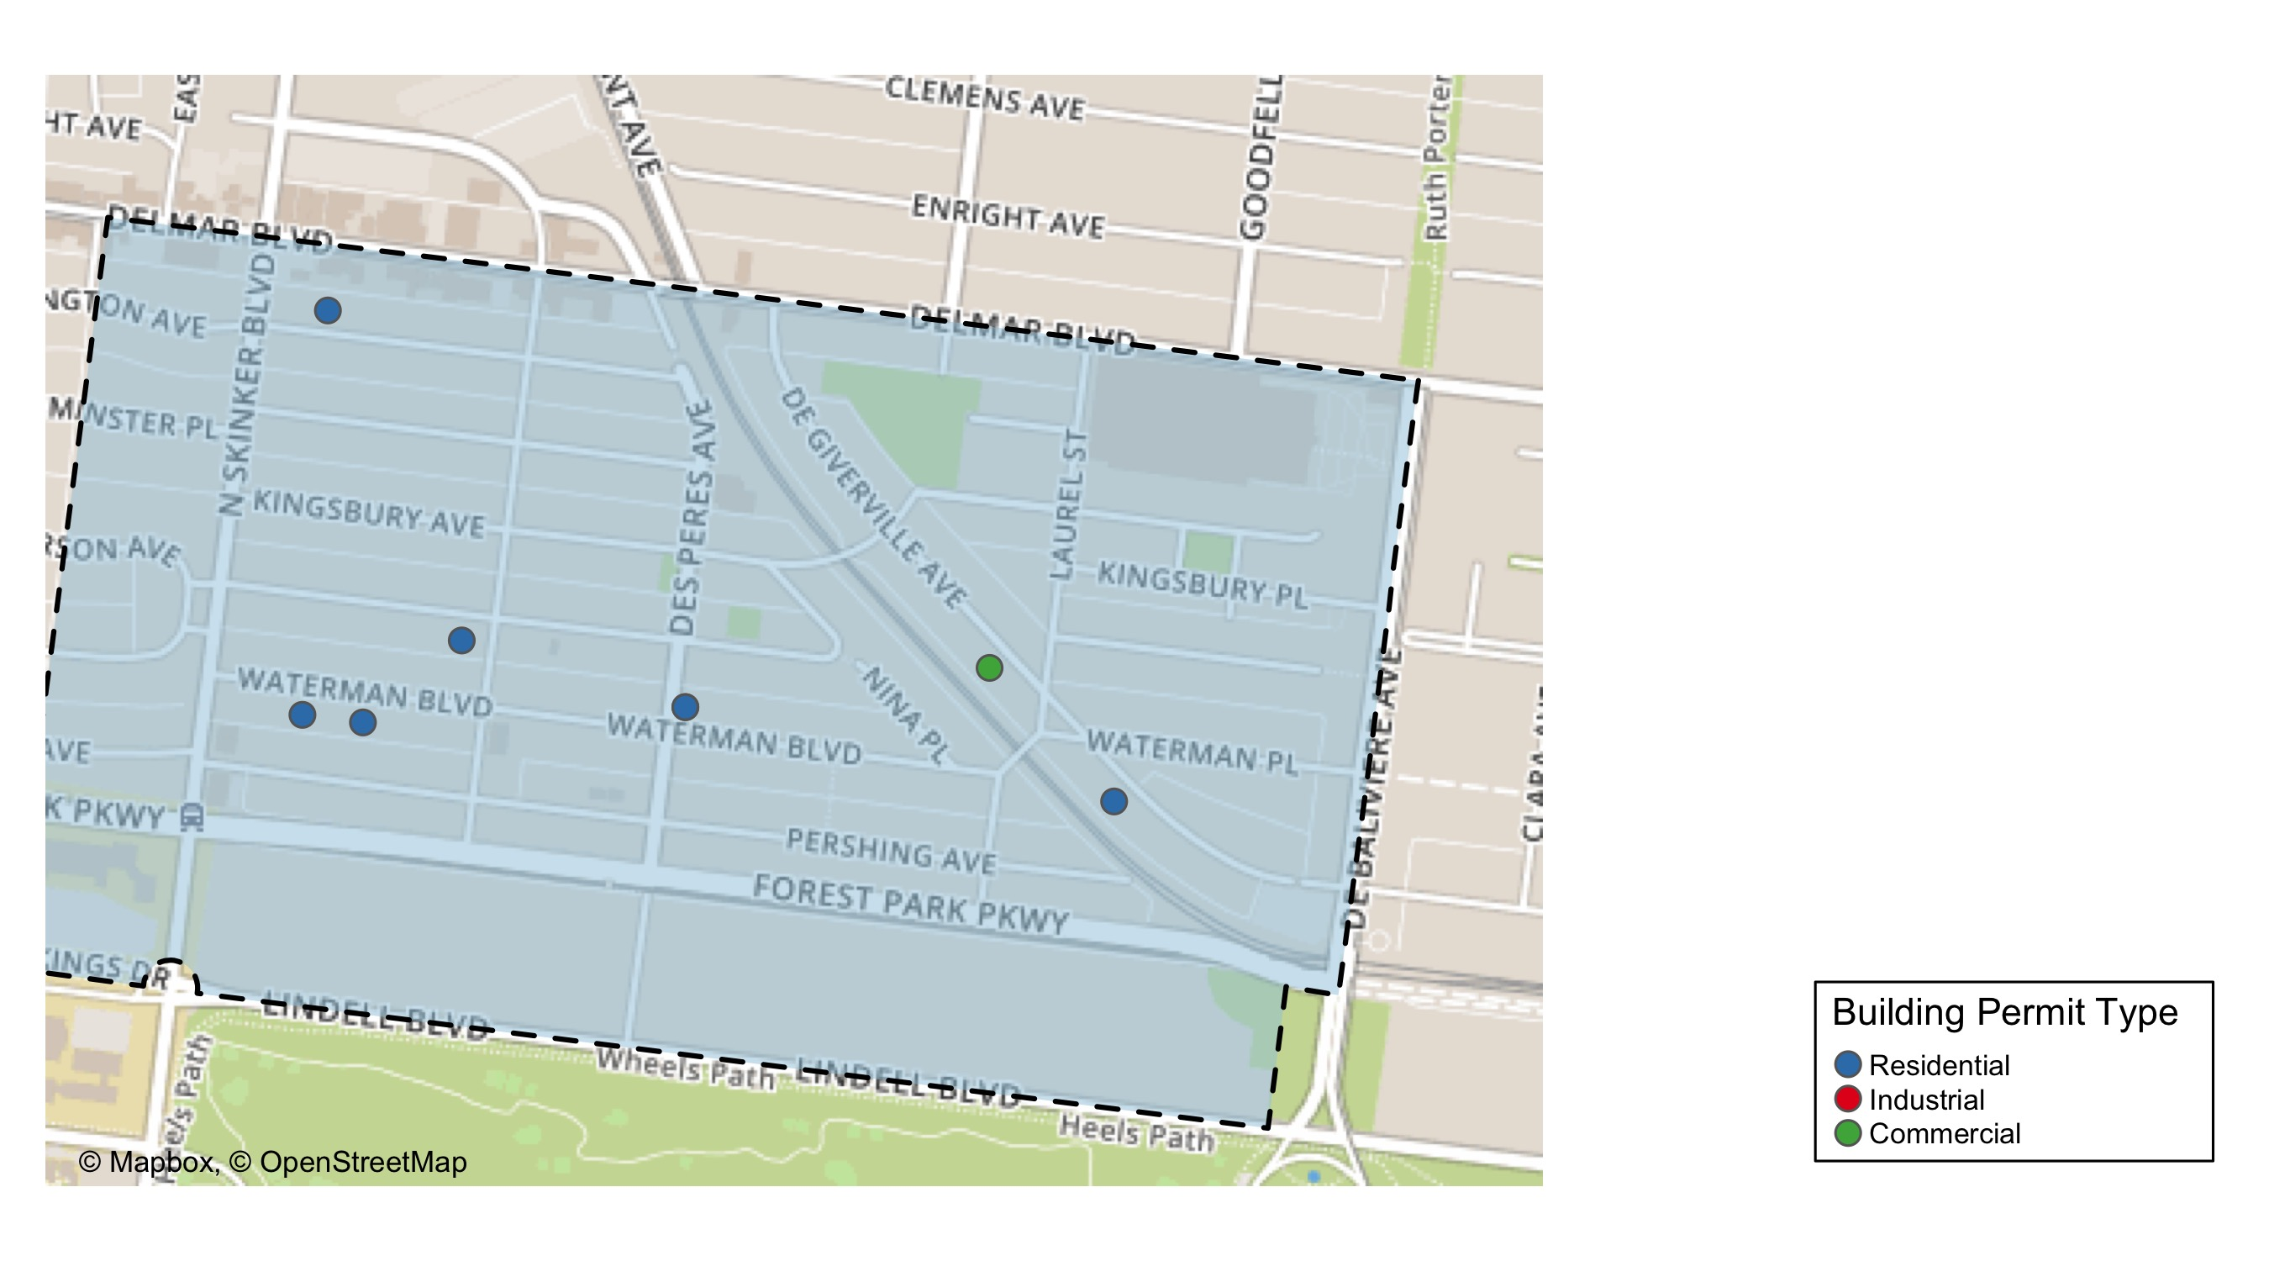
Skinker DeBaliviere

Slide 21
Neighborhood Summary
December 2021 | December 2021 | December 2021 | December 2021
Permit Use | Average Cost | # of Permits | Total Value of Permits
Commercial | $15,000.00 | 1 | $15,000
Industrial | $20,000.00 | 1 | $20,000
Residential | $50,835.62 | 8 | $406,685
Last 6 Months | Last 6 Months | Last 6 Months | Last 6 Months
Permit Use | Average Cost | # of Permits | Total Value of Permits
Commercial | $30,658.33 | 6 | $183,950
Industrial | $27,200.00 | 5 | $136,000
Residential | $169,000.24 | 38 | $6,422,009

Slide 22
Skinker DeBaliviere Individual Permit Breakdown
nbhd_name | Owner | New Use | Cost | address
Skinker DeBaliviere | NEEL, VICTORIA NICOLE | Residential | $24,775 | 5802 WATERMAN BLVD
Skinker DeBaliviere | DORN, KARLA A | Residential | $35,000 | 6254 PERSHING AV
Skinker DeBaliviere | NEEL, VICTORIA NICOLE | Industrial | $20,000 | 5802 WATERMAN BLVD
Skinker DeBaliviere | BONAN, F WILLIAM | Residential | $50,000 | 6159 LINDELL BLVD
Skinker DeBaliviere | LIPPI, CORA JEANNE TRS | Residential | $88,995 | 6238 PERSHING AV
Skinker DeBaliviere | JDJ DEVELOPMENT LLC | Commercial | $15,000 | 5874 DELMAR BLVD
Skinker DeBaliviere | GILBERT, TERRI L | Residential | $5,455 | 6144 PERSHING AV
Skinker DeBaliviere | WELCH, MARGARET & MARY LOU | Residential | $110,000 | 6189 KINGSBURY AV
Skinker DeBaliviere | PUCKETT, NATHAN SAMUEL & KRISTA MARI | Residential | $5,460 | 5782 WATERMAN BLVD
Skinker DeBaliviere | TAULBY ROACH TRS | Residential | $87,000 | 6205 MCPHERSON AV

Slide 23
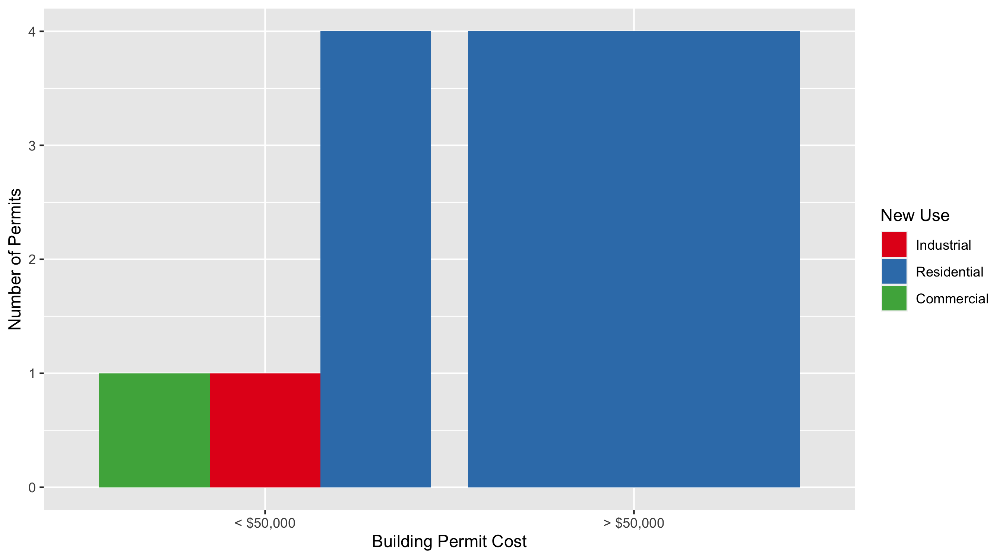
Skinker DeBaliviere Permit Cost Breakdown

Slide 24
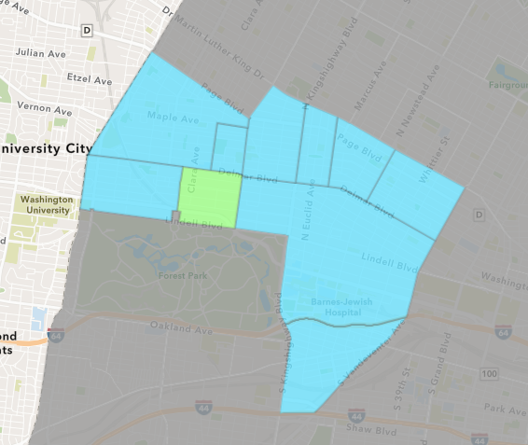
DeBaliviere Place
December 2021 Neighborhood Cost Breakdown
Mean: $55,000
Median: $55,000
Range: $30,000 - $80,000

Slide 25
DeBaliviere Place: Summary Notes
2 building permits in December 2021
-71.43% change compared to December 2020 (7 total building permits)
$55,000: Average building permit cost in December 2021
-95.23% change compared to December 2020 ($1,153,751)
54 total building permits in 2021
25.58% change YTD compared to this time in 2020 (43 total building permits)
$84,092: YTD average building permit cost in 2021
-70.94% change YTD compared to this time in 2020 ($289,387)

Slide 26
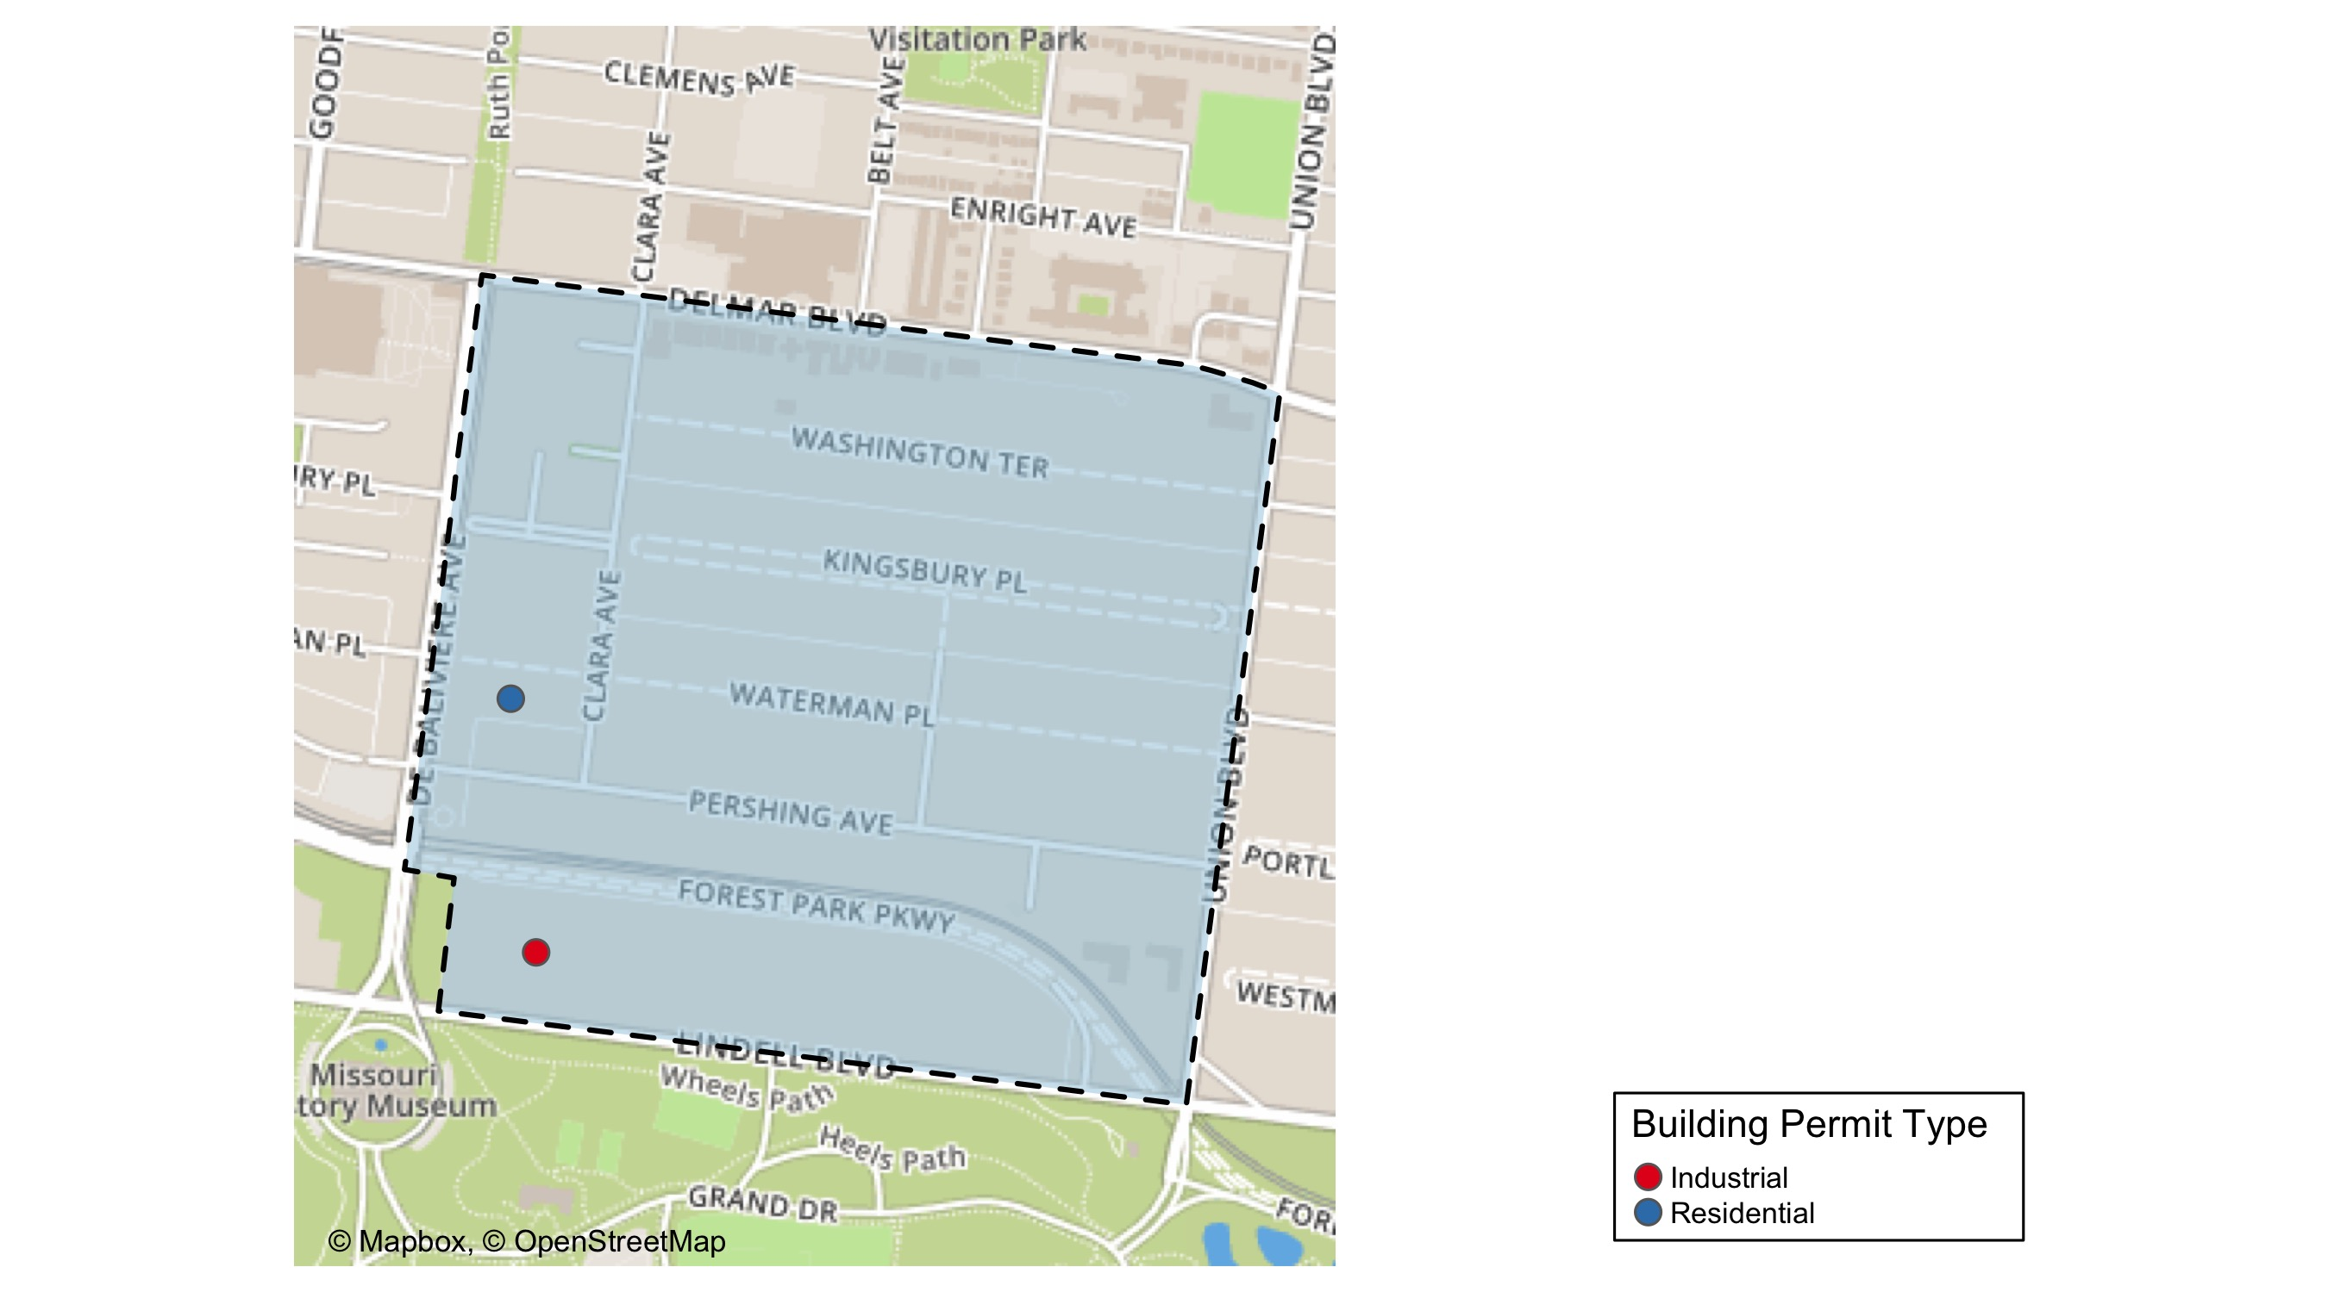
DeBaliviere Place

Slide 27
Neighborhood Summary
December 2021 | December 2021 | December 2021 | December 2021
Permit Use | Average Cost | # of Permits | Total Value of Permits
Commercial | $0 | 0 | $0
Industrial | $30,000 | 1 | $30,000
Residential | $80,000 | 1 | $80,000
Last 6 Months | Last 6 Months | Last 6 Months | Last 6 Months
Permit Use | Average Cost | # of Permits | Total Value of Permits
Commercial | $26,250.0 | 2 | $52,500
Industrial | $30,000.0 | 1 | $30,000
Residential | $101,701.2 | 23 | $2,339,128

Slide 28
DeBaliviere Place Individual Permit Breakdown
nbhd_name | Owner | New Use | Cost | address
DeBaliviere Place | KNESE, LEONARD H & SUSANNE J | Residential | $80,000 | 5505 LINDELL BLVD
DeBaliviere Place | EMERLAD CWE DE LLC & | Industrial | $30,000 | 265-275 UNION BLVD

Slide 29
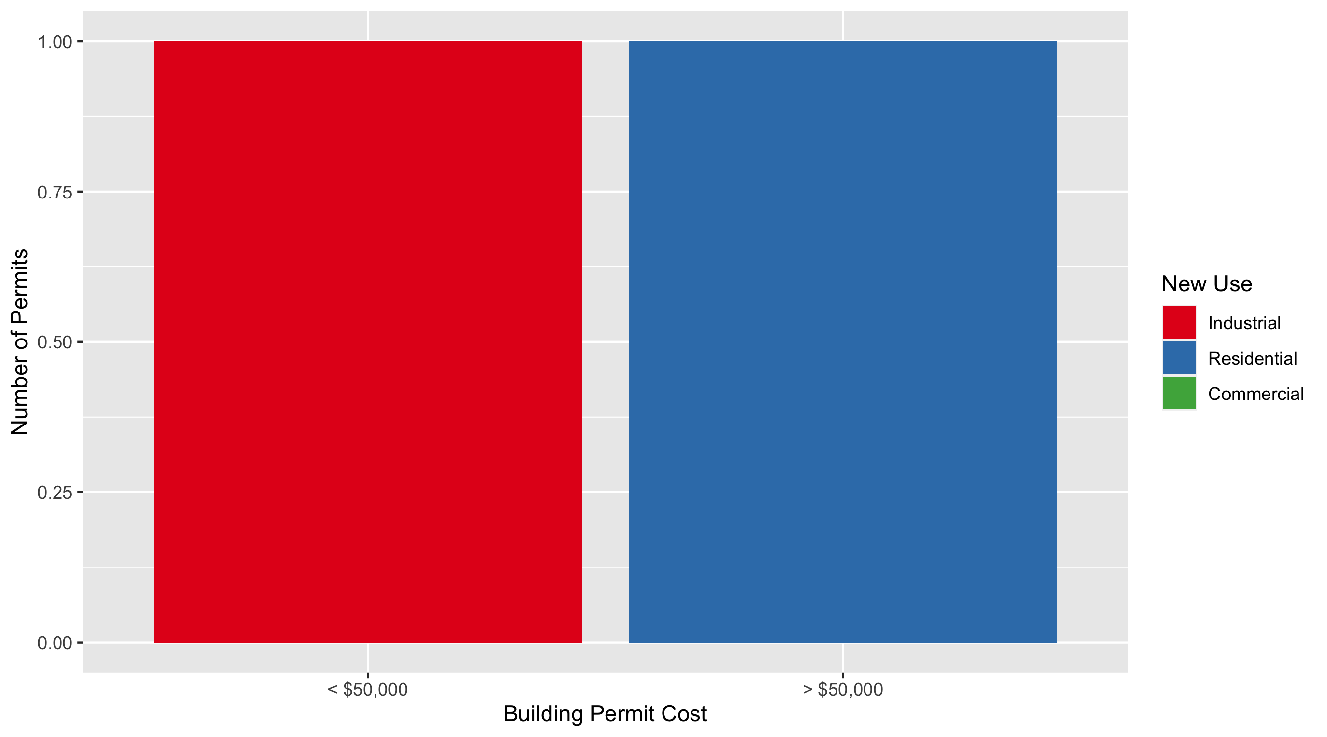
DeBaliviere Place Permit Cost Breakdown

Slide 30
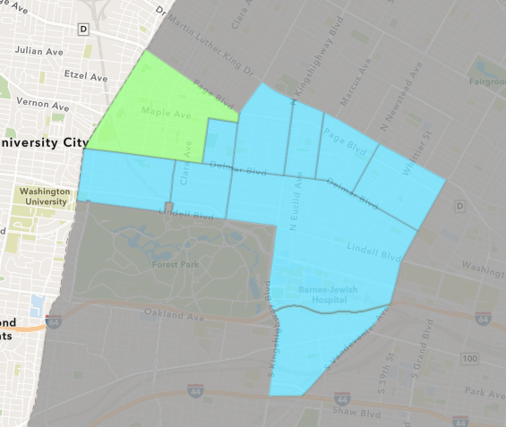
West End
December 2021 Neighborhood Cost Breakdown
Mean: $16,720
Median: $15,200
Range: $2,500 - $40,000

Slide 31
West End: Summary Notes
11 building permits in December 2021
0.00% change compared to December 2020 (11 total building permits)
$16,720: Average building permit cost in December 2021
-98.41% change compared to December 2020 ($1,053,186)
142 total building permits in 2021
67.06% change YTD compared to this time in 2020 (85 total building permits)
$68,547: YTD average building permit cost in 2021
-80.53% change YTD compared to this time in 2020 ($352,056)

Slide 32
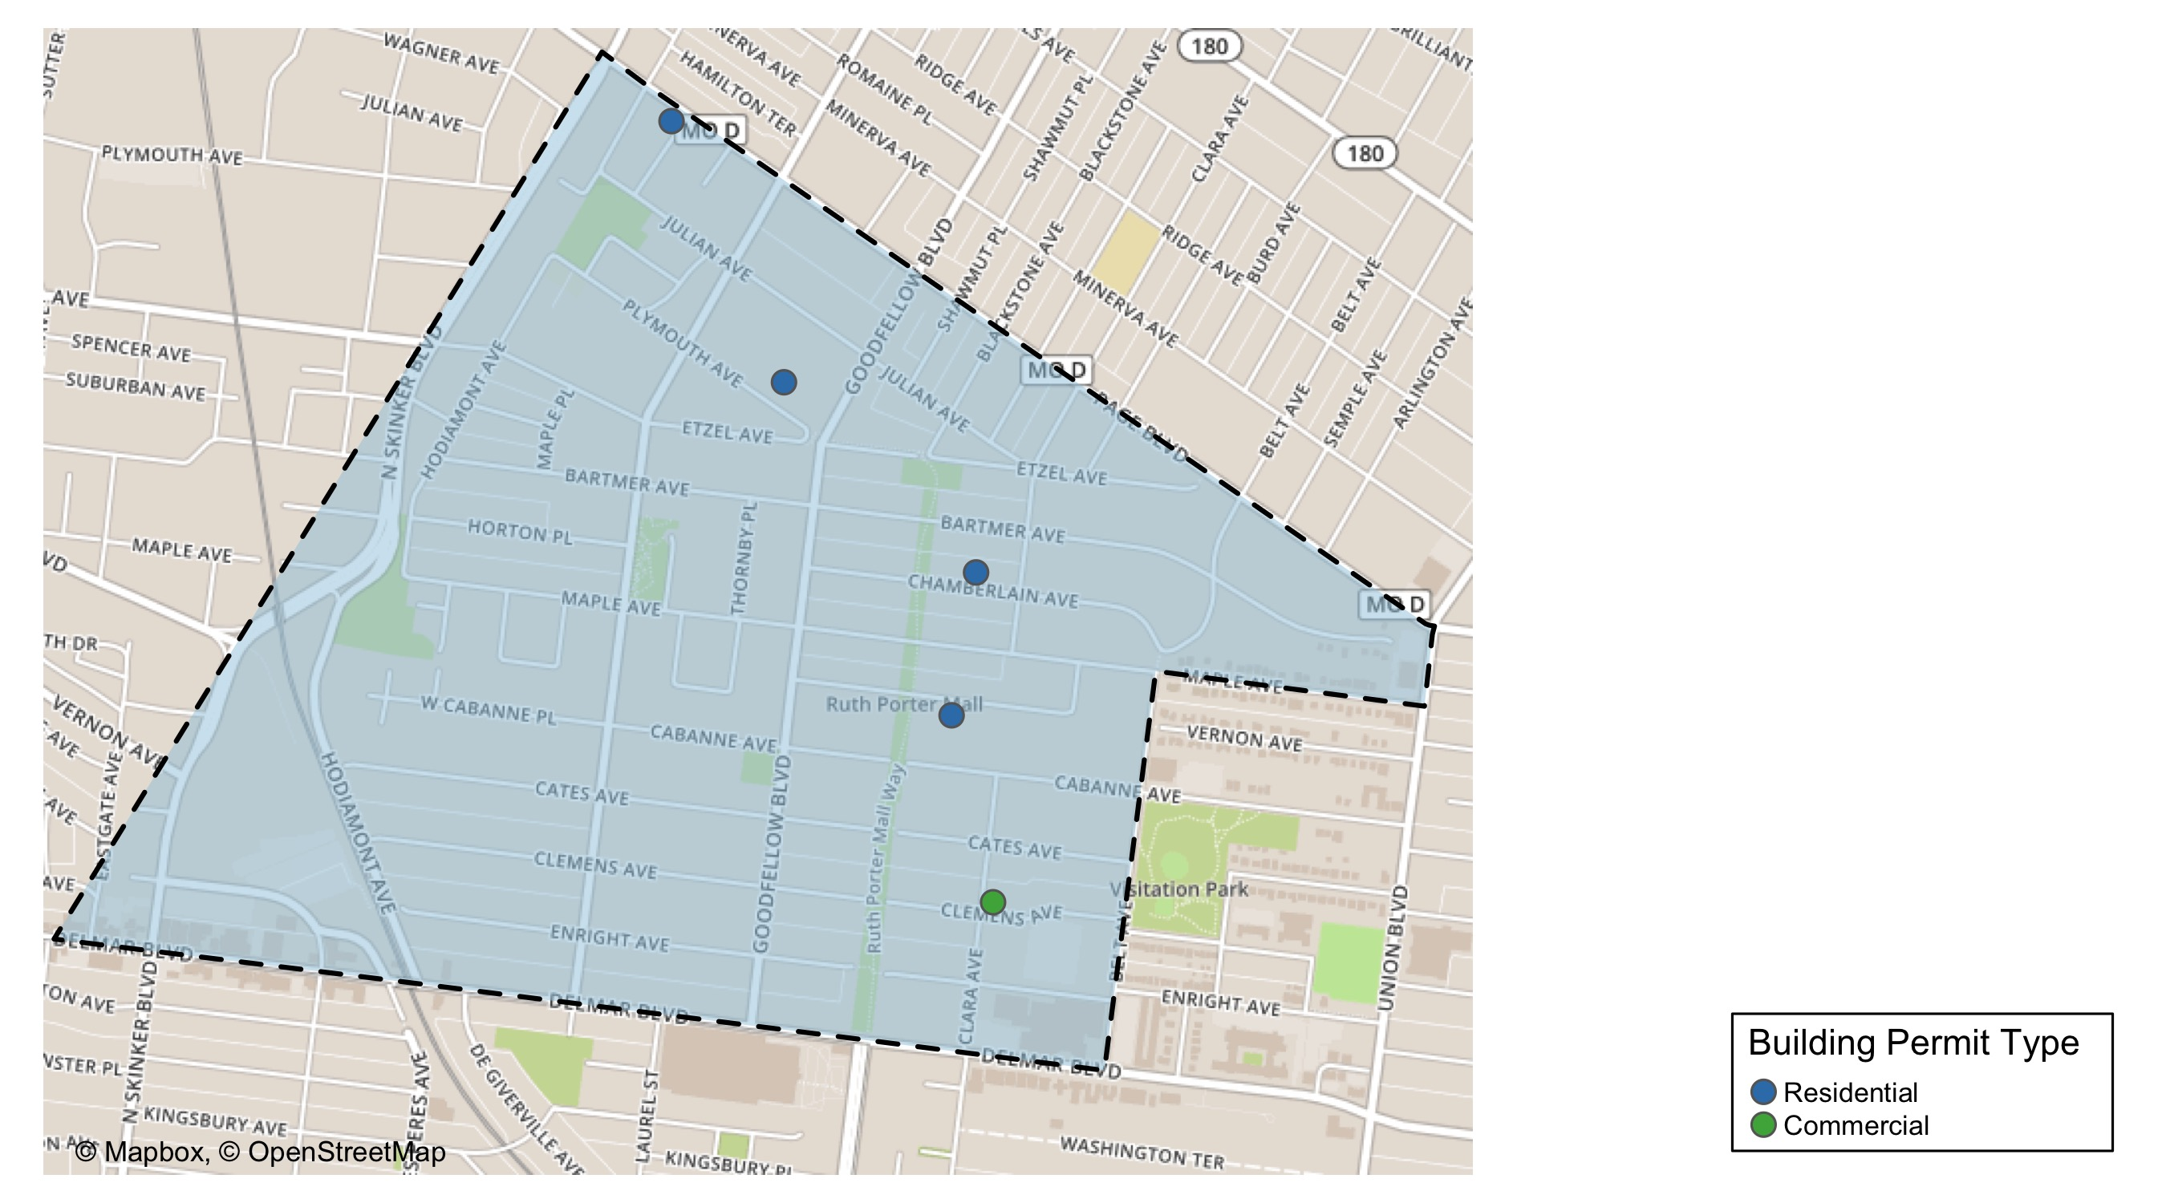
West End

Slide 33
Neighborhood Summary
December 2021 | December 2021 | December 2021 | December 2021
Permit Use | Average Cost | # of Permits | Total Value of Permits
Commercial | $6,841.50 | 4 | $27,366
Industrial | $0.00 | 0 | $0
Residential | $22,364.29 | 7 | $156,550
Last 6 Months | Last 6 Months | Last 6 Months | Last 6 Months
Permit Use | Average Cost | # of Permits | Total Value of Permits
Commercial | $45,670.00 | 47 | $2,146,490
Industrial | $28,487.00 | 3 | $85,461
Residential | $30,317.22 | 49 | $1,485,544

Slide 34
West End Individual Permit Breakdown
nbhd_name | Owner | New Use | Cost | address
West End | DELMAR DIVINE MASTER LANDLORD | Commercial | $3,117 | 5535 DELMAR BLVD
West End | DELMAR DIVINE MASTER LANDLORD | Commercial | $11,317 | 5535 DELMAR BLVD
West End | DELMAR DIVINE MASTER LANDLORD | Commercial | $3,069 | 5525 DELMAR BLVD
West End | LOVE, CASSANDRA | Residential | $35,000 | 1200 OAKLEY PL
West End | MACK, NATHAN | Residential | $40,000 | 5545 MAPLE AV
West End | BETTY JEAN KERR PEOPLES HEALTH CENTE | Commercial | $9,863 | 5647 DELMAR BLVD
West End | GREEN, KATRINA | Residential | $15,200 | 5736 BARTMER AV
West End | COLLINS, HARVEY L & RENEE A | Residential | $27,850 | 5621 CABANNE AV
West End | JACKSON, DARRYL FREEMAN | Residential | $16,000 | 5640 CHAMBERLAIN AV
West End | WILLIAMS, LUCRETIA | Residential | $20,000 | 5872 JULIAN AV
West End | WATERMAN PROPERTIES | Residential | $2,500 | 6010 BARTMER AV

Slide 35
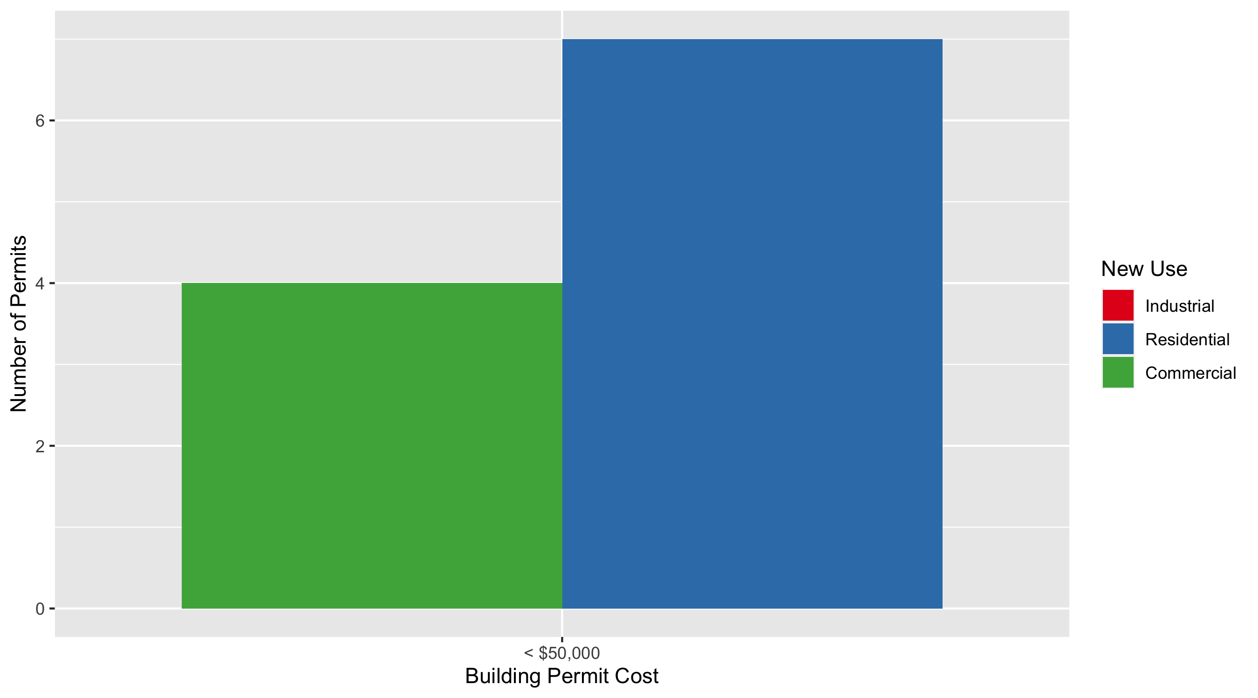
West End Permit Cost Breakdown

Slide 36
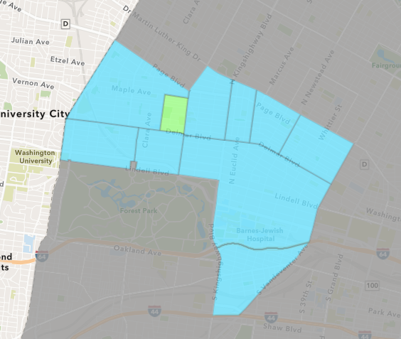
Visitation Park
December 2021 Neighborhood Cost Breakdown
Mean: $82,500
Median: $82,500
Range: $65,000 - $100,000

Slide 37
Visitation Park: Summary Notes
2 building permits in December 2021
100.00% change compared to December 2020 (1 total building permits)
$82,500: Average building permit cost in December 2021
961.23% change compared to December 2020 ($7,774)
4 total building permits in 2021
-42.86% change YTD compared to this time in 2020 (7 total building permits)
$42,475: YTD average building permit cost in 2021
153.63% change YTD compared to this time in 2020 ($16,747)

Slide 38
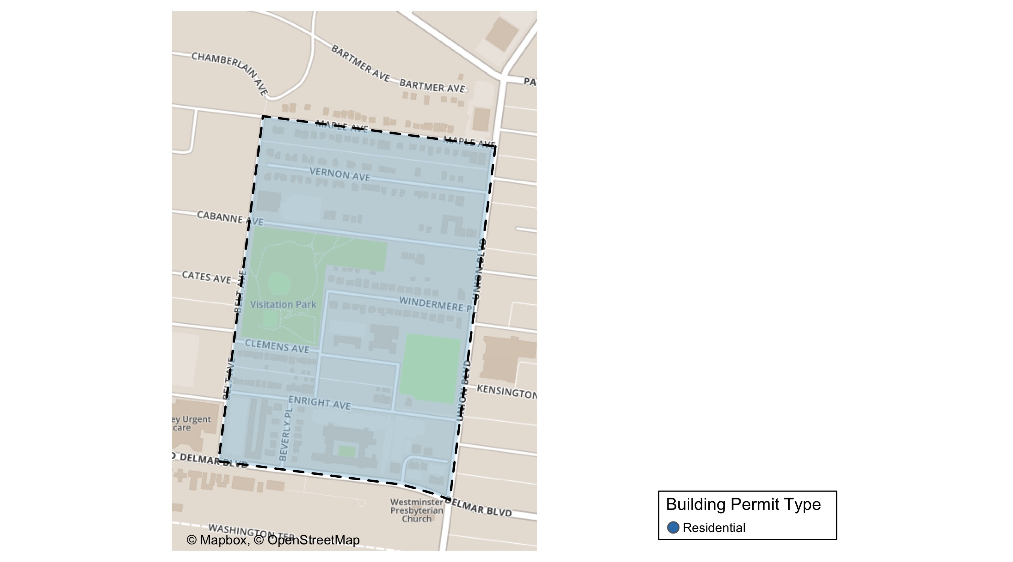
Visitation Park

Slide 39
Neighborhood Summary
December 2021 | December 2021 | December 2021 | December 2021
Permit Use | Average Cost | # of Permits | Total Value of Permits
Commercial | $0 | 0 | $0
Industrial | $0 | 0 | $0
Residential | $82,500 | 2 | $165,000
Last 6 Months | Last 6 Months | Last 6 Months | Last 6 Months
Permit Use | Average Cost | # of Permits | Total Value of Permits
Commercial | $0 | 0 | $0
Industrial | $0 | 0 | $0
Residential | $42,475 | 4 | $169,900

Slide 40
Visitation Park Individual Permit Breakdown
nbhd_name | Owner | New Use | Cost | address
Visitation Park | RB DELMAR LLC | Residential | $65,000 | 5305 DELMAR BLVD
Visitation Park | FOREST PARK APTS LP | Residential | $100,000 | 5451-63 DELMAR BLVD

Slide 41
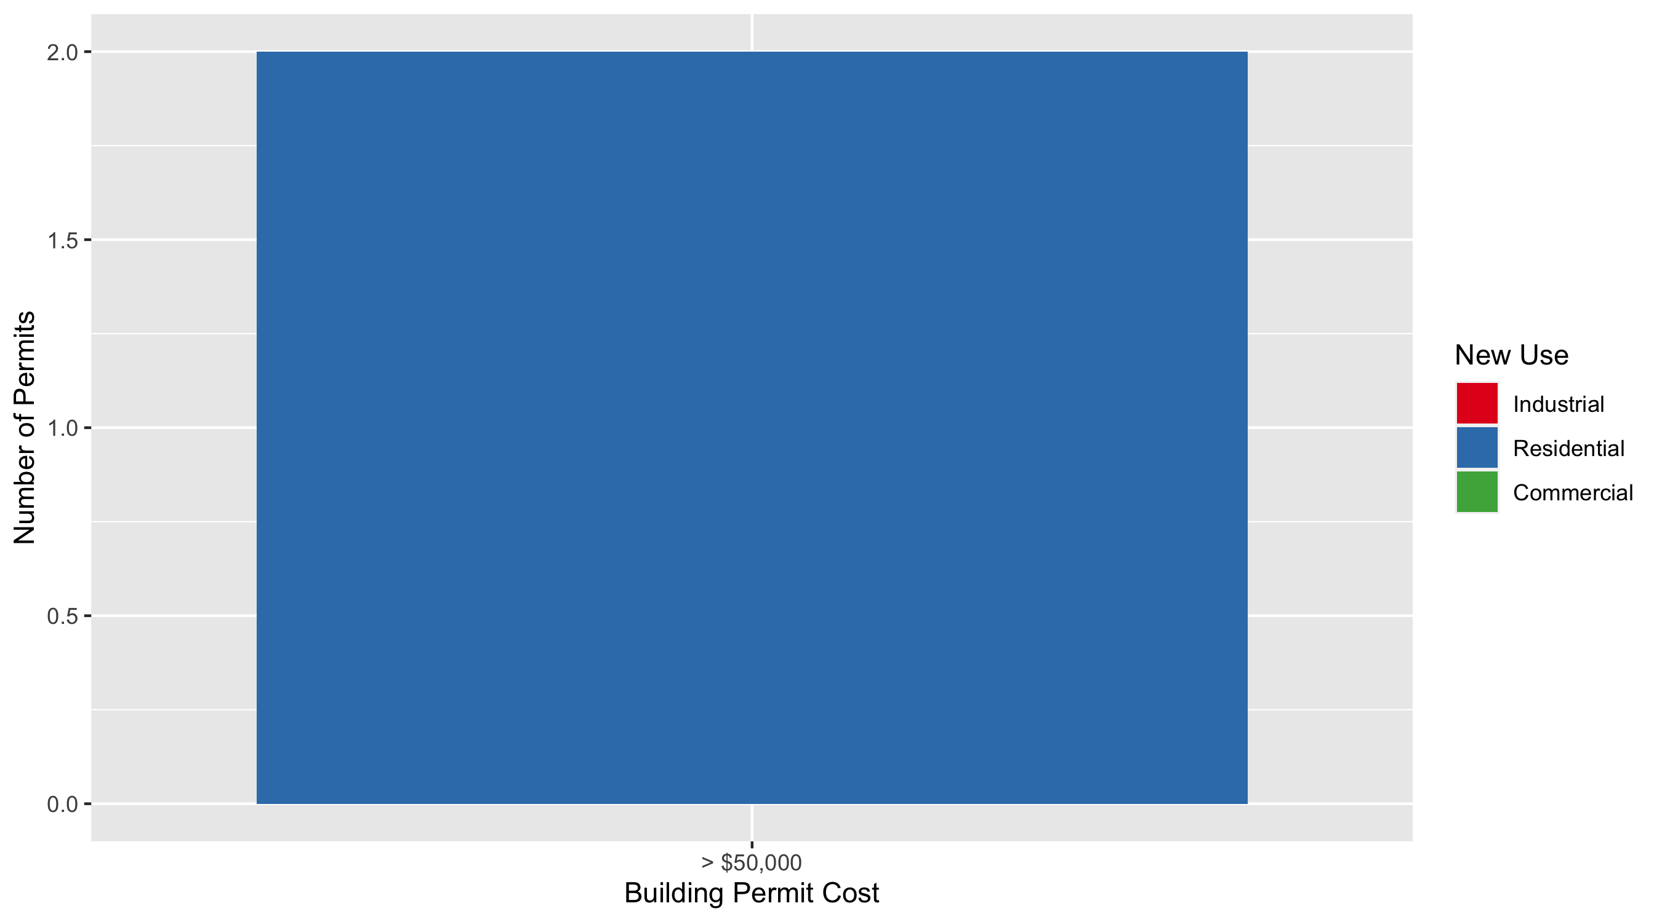
Visitation Park Permit Cost Breakdown

Slide 42
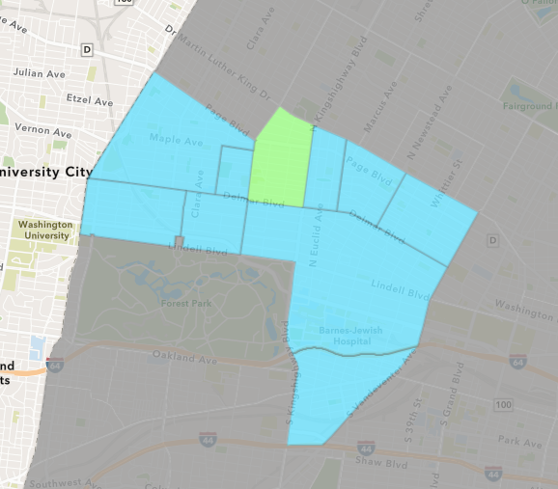
Academy
December 2021 Neighborhood Cost Breakdown
Mean: $27,984
Median: $30,218
Range: $1,500 - $50,000

Slide 43
Academy: Summary Notes
4 building permits in December 2021
-33.33% change compared to December 2020 (6 total building permits)
$27,984: Average building permit cost in December 2021
-8.64% change compared to December 2020 ($30,629)
38 total building permits in 2021
5.56% change YTD compared to this time in 2020 (36 total building permits)
$41,327: YTD average building permit cost in 2021
-7.18% change YTD compared to this time in 2020 ($44,526)

Slide 44
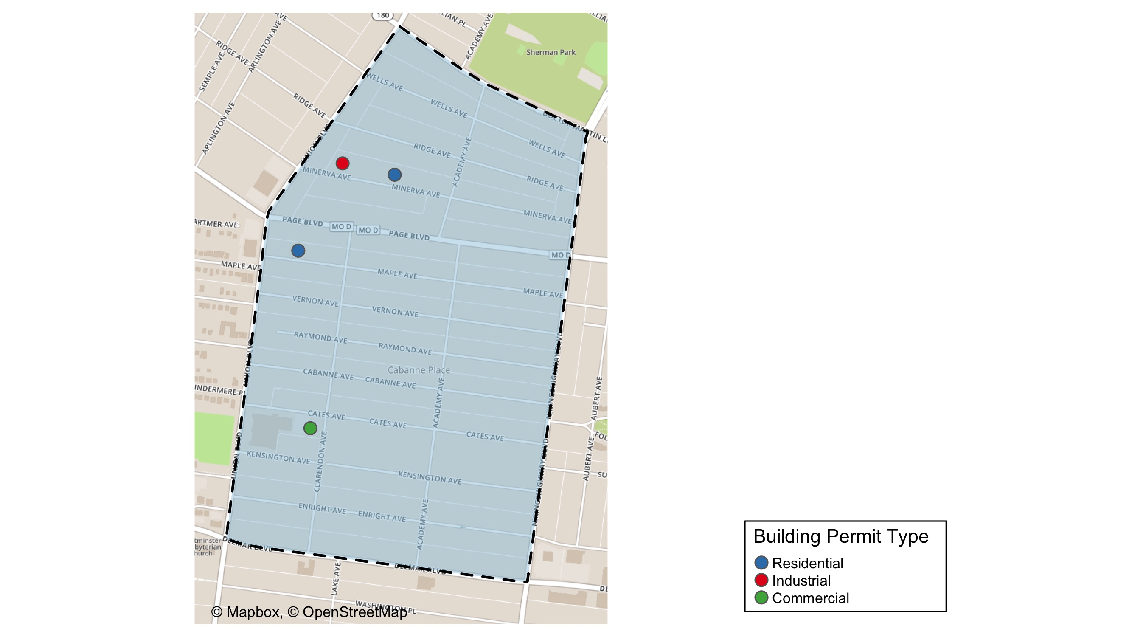
Academy

Slide 45
Neighborhood Summary
December 2021 | December 2021 | December 2021 | December 2021
Permit Use | Average Cost | # of Permits | Total Value of Permits
Commercial | $50,000 | 1 | $50,000
Industrial | $1,500 | 1 | $1,500
Residential | $30,218 | 2 | $60,436
Last 6 Months | Last 6 Months | Last 6 Months | Last 6 Months
Permit Use | Average Cost | # of Permits | Total Value of Permits
Commercial | $104,060.00 | 5 | $520,300
Industrial | $760.00 | 5 | $3,800
Residential | $17,268.11 | 18 | $310,826

Slide 46
Academy Individual Permit Breakdown
nbhd_name | Owner | New Use | Cost | address
Academy | LOVINGS, MARION D & MAXINE | Residential | $49,151 | 5221 MAPLE AV
Academy | CRAWFORD, POMP L & LUE C | Residential | $11,285 | 5138 RIDGE AV
Academy | LOTT, TAMMY | Commercial | $50,000 | 5201 DELMAR BLVD
Academy | E & R LANDSCAPING LLC | Industrial | $1,500 | 5129 MINERVA AV

Slide 47
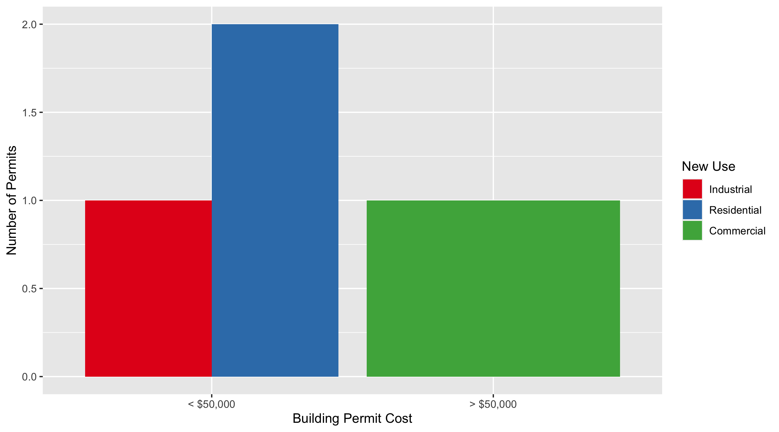
Academy Permit Cost Breakdown

Slide 48
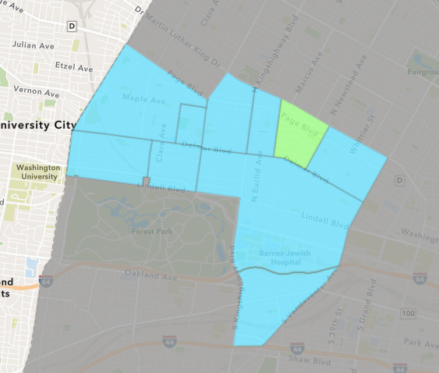
Lewis Place
December 2021 Neighborhood Cost Breakdown
Mean: $52,950
Median: $52,950
Range: $5,900 - $100,000

Slide 49
Lewis Place: Summary Notes
2 building permits in December 2021
0.00% change compared to December 2020 (2 total building permits)
$52,950: Average building permit cost in December 2021
400.95% change compared to December 2020 ($10,570)
22 total building permits in 2021
69.23% change YTD compared to this time in 2020 (13 total building permits)
$69,559: YTD average building permit cost in 2021
137.90% change YTD compared to this time in 2020 ($29,238)

Slide 50
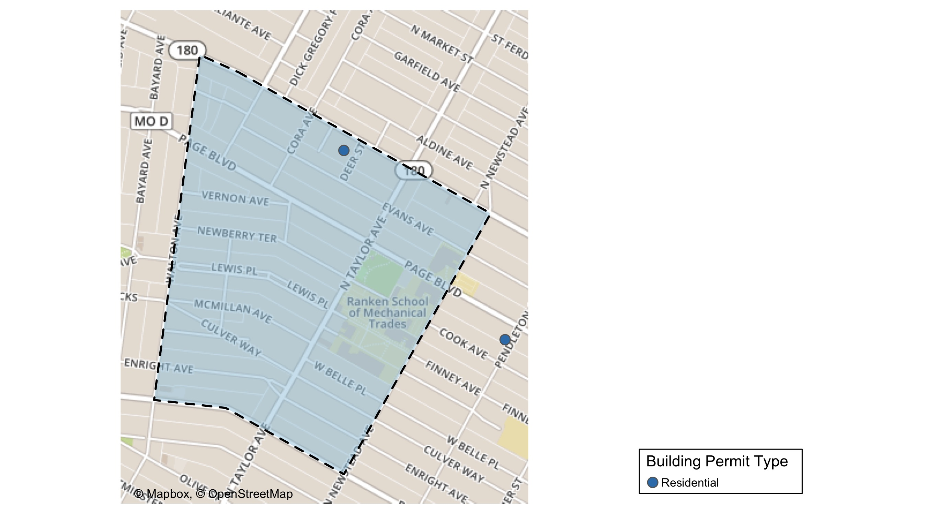
Lewis Place

Slide 51
Neighborhood Summary
December 2021 | December 2021 | December 2021 | December 2021
Permit Use | Average Cost | # of Permits | Total Value of Permits
Commercial | $0 | 0 | $0
Industrial | $0 | 0 | $0
Residential | $52,950 | 2 | $105,900
Last 6 Months | Last 6 Months | Last 6 Months | Last 6 Months
Permit Use | Average Cost | # of Permits | Total Value of Permits
Commercial | $279,084 | 4 | $1,116,336
Industrial | $20,000 | 3 | $60,000
Residential | $35,700 | 7 | $249,900

Slide 52
Lewis Place Individual Permit Breakdown
nbhd_name | Owner | New Use | Cost | address
Lewis Place | YESHITELA, ONA ZENE & OMALI | Residential | $100,000 | 4563 LEWIS PL
Lewis Place | XTREME HOLDINGS LLC | Residential | $5,900 | 4628 EVANS AV

Slide 53
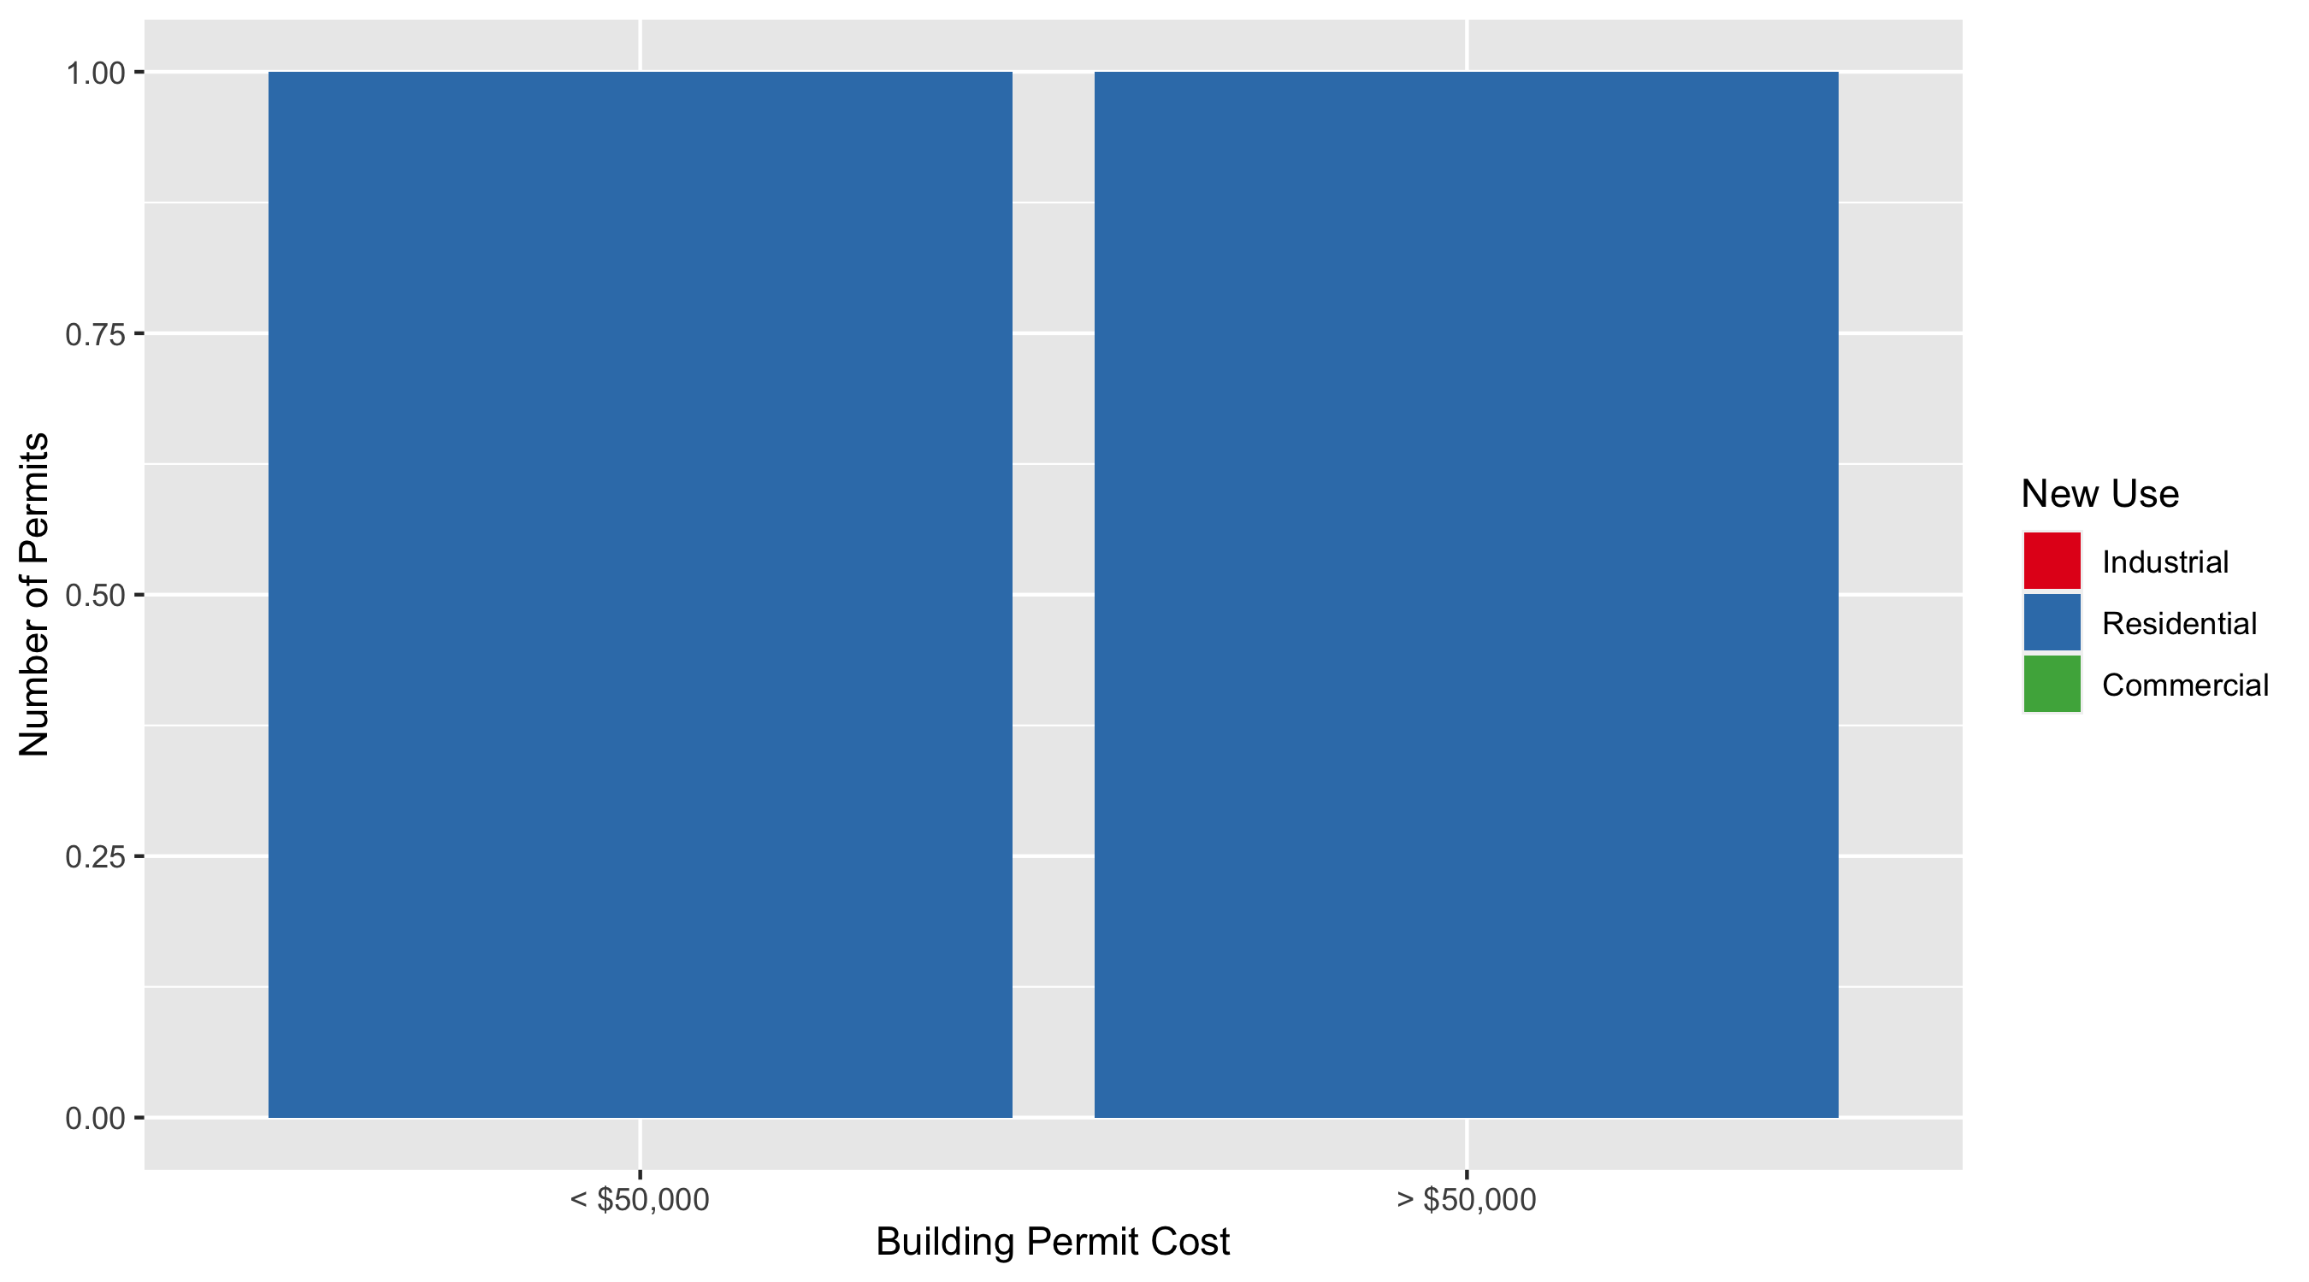
Lewis Place Permit Cost Breakdown

Slide 54
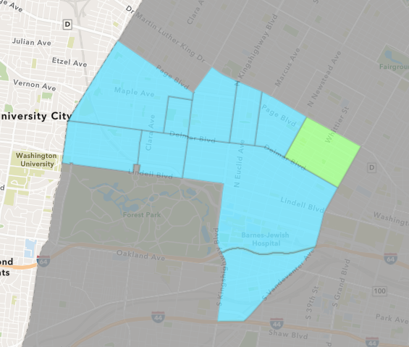
Vandeventer
December 2021 Neighborhood Cost Breakdown
Mean: $7,622
Median: $7,622
Range: $7,622 - $7,622

Slide 55
Vandeventer: Summary Notes
1 building permits in December 2021
-75.00% change compared to December 2020 (4 total building permits)
$7,622: Average building permit cost in December 2021
-46.81% change compared to December 2020 ($14,331)
16 total building permits in 2021
0.00% change YTD compared to this time in 2020 (16 total building permits)
$85,859: YTD average building permit cost in 2021
106.87% change YTD compared to this time in 2020 ($41,503)

Slide 56
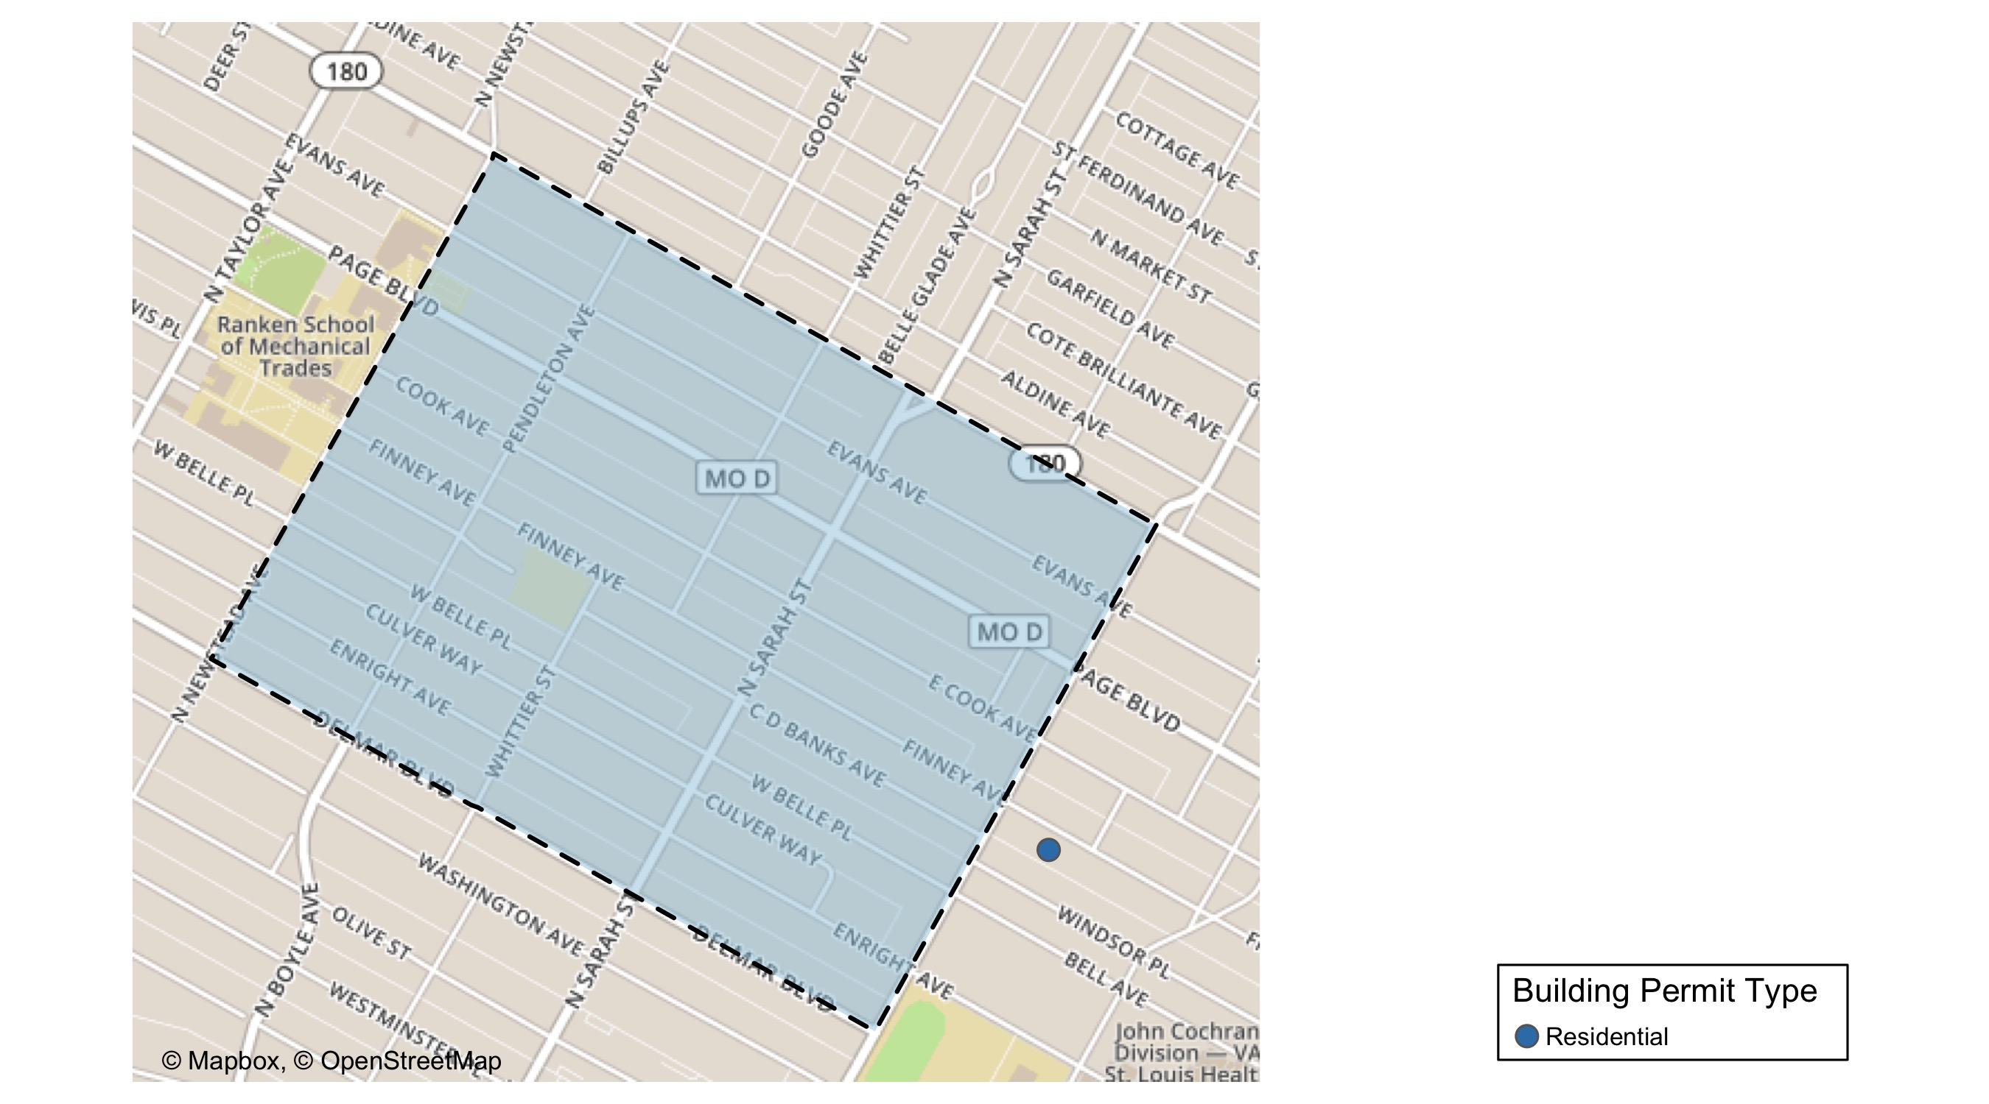
Vandeventer

Slide 57
Neighborhood Summary
December 2021 | December 2021 | December 2021 | December 2021
Permit Use | Average Cost | # of Permits | Total Value of Permits
Commercial | $0 | 0 | $0
Industrial | $0 | 0 | $0
Residential | $7,622 | 1 | $7,622
Last 6 Months | Last 6 Months | Last 6 Months | Last 6 Months
Permit Use | Average Cost | # of Permits | Total Value of Permits
Commercial | $0.000 | 0 | $0
Industrial | $4,266.667 | 3 | $12,800
Residential | $104,688.308 | 13 | $1,360,948

Slide 58
Vandeventer Individual Permit Breakdown
nbhd_name | Owner | New Use | Cost | address
Vandeventer | NEAL, YOLANDA | Residential | $7,622 | 4219 W FINNEY AV

Slide 59
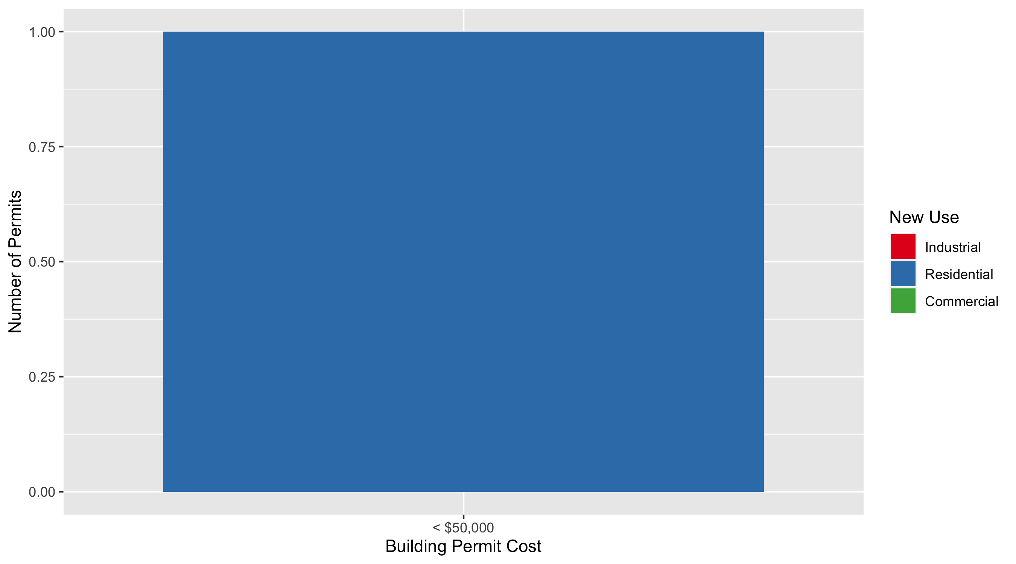
Vandeventer Permit Cost Breakdown

Slide 60
Additional Notes
Data retreived from https://www.stlouis-mo.gov/data/
Building permits with a cost of $0 were dropped
Building permits that were cancelled were dropped
Infinite change indicates 0 permits in the current or previous time period/comparison month so there was a overall increase or decrease

